Slide 1
Comp1828: Advanced Algorithms and Data Structures
Dr Ik Soo Lim

Slide 2
Module Leader
Dr Ik Soo Lim
i.lim@gre.ac.uk
Queen Mary 360
Office Hours: Check out Moodle
https://moodlecurrent.gre.ac.uk/course/view.php?id=104359#section-3
For other hours, appointment by emails

Slide 3
Module Structure
Lectures :
12:00 – 13:50 OR 14:00 – 15:50, Monday, 11_0003 (LT)
Please check your timetables to see which lecture you have been assigned to
For any time-table matters, contact the CMS office
Labs: Monday
A series of 1-hour labs
Please check your timetables to see which lab and tutor you have been assigned to
Please create a Google account to use Google Colab if you have no Google account.

Slide 4
Assessment (1)
Coursework (50%)
Group work
Coursework specification: published around 15 Oct 2024
Deadline: 11:30 pm, 18 Nov 2024, UK (GMT)
Exam (50%)
Open-ended questions
No multiple choices, No open-book
Mock exam questions as weekly lab tasks
Jan 2025

Slide 5
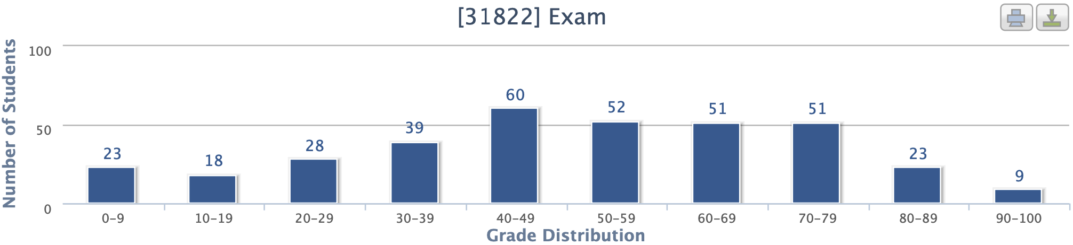
Assessment (2)
2023 - 24
0-9 | 10-19 | 20-29 | 30-39 | 40-49 | 50-59 | 60-69 | 70-79 | 80-89 | 90-100
7.2% | 5.3 | 8.1 | 11.1 | 16.7 | 14.4 | 14.2 | 14.2 | 6.4 | 2.5%
31.7 % |  |  |  | 45.3 |  |  | 23.1

Slide 6
Planned Schedule of Lectures
Week No. | Date | 2-hour lecture + 1-hour IT lab
1 | 23 Sep 2024 | Introduction (by Ik Soo)
2 | 30 Sep | Data structures I
3 | 7 Oct | Data structures II
4 | 14 Oct | Algorithms on graphs I
5 | 21 Oct | Algorithms on graphs II
6 | 28 Oct | Topics on Algorithms
7 | 4 Nov | Skills Week (No Teaching)
8 | 11 Nov | Dynamic Programming I (by Razia)
9 | 18 Nov | Dynamic Programming II
10 | 25 Nov | Algorithms on strings I
11 | 2 Dec | Algorithms on strings II
12 | 9 Dec | Revision
 | TBA (Jan 2025) | Exam

Slide 7
How do I succeed in COMP 1828?
Engage with all lectures/labs/mock exams
These are designed to help you get a high score
Attempt to complete all lab work
Need to work for at least 9 hours each week
For every taught hour, you should put in two extra hours
Start coursework early
Exam in January – do not miss essential revision class

Slide 8
Ground Rules
Engagement
Follow the instructions on the Moodle page to join in and engage with all scheduled sessions
Your responsibility to keep up / catch up
Recorded lectures and all teaching material will be online
Please be considerate to others in sessions
Follow protocol so all students present can engage with the activity
Avoid academic misconduct – please ask if you are unsure
Do not copy from another student or allow someone to copy your work
Do not ask/pay someone else to do you work
Do not copy from other sources without proper referencing

Slide 9
Communication / Information
Login to the Moodle page regularly and check for any new items
https://moodlecurrent.gre.ac.uk/course/view.php?id=104359
Course details: handbook, slides, labs, coursework
Announcements: cancellation, change of room, time etc.
Module News and Announcements Forum
Post Questions to the Module Teaching Team Forum
Check your email regularly
Course related matters
Contact the module leader as soon as possible
Email will be responded within three (working) days

Slide 10

Job Interviews (1)

Slide 11

Job Interviews (2)
``The most crucial modules for job interviews were :
Programming (Python) & Algorithms.’’
Anurag S Rawat
- Completed work placement from July 2022 to June 2023
- Currently employed at General Electric in Cambridge since June 2024

Slide 12

Job Interviews (3)
I am writing this email to talk about my experience with Placement Year interviews and how the module Advanced Algorithms and data structures influenced it.
… during the last round of interviews my task was to solve a problem while going through my thought process or explaining the concept of some chosen topics. These topics were covered in the Advanced Algorithms module in depth and helped me a lot.
The exam for Advanced Algorithms helped me learn the in-depth concept and understanding behind these Algorithms instead of just quick answers. This understanding of the concept proved crucial in my final round of interviews.
In one of my interviews, I was asked to explain the concept of Binary Search Tree. Since this was well taught in the lectures, I was able to confidently answer.
I am deeply grateful that this Module was taught before my Placement Year interviews.
Best Regards,
Reda Fatima
Citibank placement: Jul 2023 - Jun 2024
Yr 3 student (2024-25); offered Citibank job

Slide 13
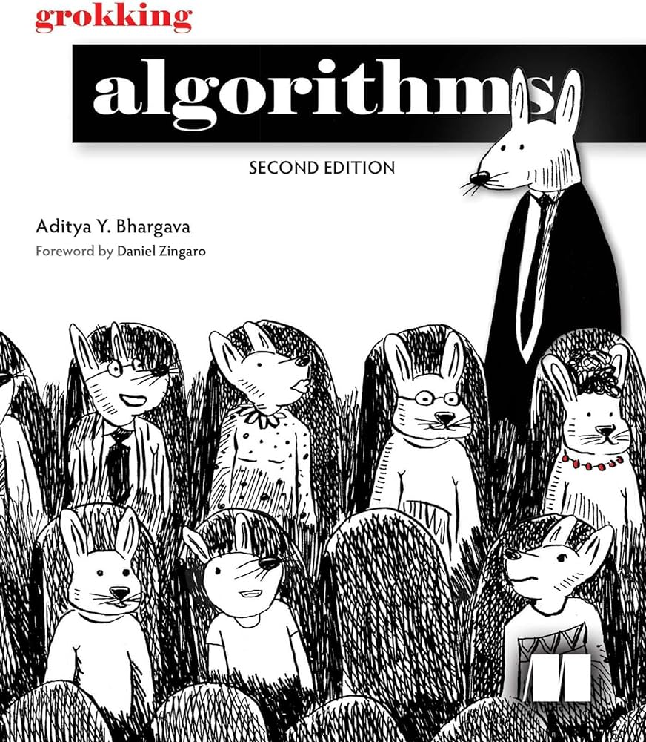
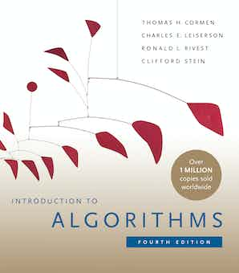

Books
Author | Title | Publisher | ISBN
Bhargava, Aditya Y. | Grokking Algorithms: An illustrated guide for programmers and other curious people, 2nd ed. | Manning Publications | 9781638354567 | Required
Cormen, Thomas H.; Leiserson, Charles E. | Introduction to Algorithms, 4th ed. | MIT Press | 026204630X | Required
Goodrich, Michael T.; Tamassia, Roberto; Goldwasser, Michael H. | Data Structures and Algorithms in Python | Wiley | 1118290275 | Recommended
LibrarySearch/Publication Finder at
https://publications.ebsco.com/?custId=s5848088&groupId=main&profileId=pfui

Slide 14
ASYMPTOTIC COMPLEXITY (REVISION)

Slide 15
What Affects the Performance of Algorithms?
Complexity of underlying algorithm
Size of the input
…
Measure of performance is a function of the input size

Slide 16
Time Complexity and Space Complexity
Time complexity describes the elapsed time associated with executing the application.
This could involve numerical, transfer of data between files/systems
Space complexity describes the memory requirements needed to handle the data in the application

Slide 17
Analysis of the Performance Using Asymptotic Notation (1)
Want to analyse the performance (e.g., complexity) without experiments.
We mathematically describe asymptotic behaviour of the performance
Advantages
Ignores constant factor: measures intrinsic efficiency
Only considers the dominating term: dominates efficiency for large input sizes

Slide 18
Analysis of the Performance Using Asymptotic Notation (2)
Want to analyse the performance (e.g., complexity) without experiments.
We mathematically describe asymptotic behaviour of the performance
Calculate the complexity as a function of input size 𝑛
We focus on the asymptotic order of the complexity.
We say 𝑇(𝑛) = 2𝑛² + 9𝑛 is on the order of 𝑛².
Advantages
Ignores constant factor: measures intrinsic efficiency
Only considers the dominating term: dominates efficiency for large input sizes

Slide 19
Asymptotic Notation (1)
Big-O: the asymptotic upper bound of a function
4𝑛³ + 7 𝑛² + 𝑛 log 𝑛 = 𝑂(𝑛³)
3𝑛 log 𝑛 − 𝑛 = 𝑂(𝑛 log 𝑛)
• Note: the following may hold in principle, but not recommended if we know a tighter bound.
• 𝑛² = 𝑂(𝑛³), 𝑛² = 𝑂(𝑛⁴), 𝑛² = 𝑂(2^{𝑛})
• Many textbooks assume that only 𝑛² = 𝑂(𝑛²) is correct and others are incorrect.

Slide 20
Asymptotic Notations (2)
Big-O: the asymptotic upper bound of a function
4𝑛³ + 7 𝑛² + 𝑛 log 𝑛 = 𝑂(𝑛³)
3𝑛 log 𝑛 − 𝑛 = 𝑂(𝑛 log 𝑛)
• Note: the following may hold in principle, but not recommended if we know a tighter bound.
• 𝑛² = 𝑂(𝑛³), 𝑛² = 𝑂(𝑛⁴), 𝑛² = 𝑂(2^{𝑛})
• Many textbooks assume that only 𝑛² = 𝑂(𝑛²) is correct and others are incorrect.
Big-Omega Ω, Big-Theta Θ

Slide 21
Asymptotic Notations (3)
Ignore all the constant factors
Find the most dominating term
1<log 𝑛< (log 𝑛)² <⋯<𝑛<𝑛 log 𝑛<𝑛 (log 𝑛)² <⋯<𝑛² < 𝑛² log 𝑛<𝑛² (log 𝑛)² <⋯<𝑛³ <⋯<2^{𝑛} < 2^{𝑛} log 𝑛<⋯< 2^{𝑛} 𝑛 <2^{𝑛} 𝑛 log 𝑛<⋯<2^{𝑛}𝑛² <⋯<3^{𝑛} <⋯<𝑛!<𝑛^{𝑛} (more dominating to the right)
4𝑛³ + 7 𝑛² + 𝑛 log 𝑛 = 𝑂(𝑛³)
3𝑛 log 𝑛 − 𝑛 = 𝑂(𝑛 log 𝑛)

Slide 22
Examples of Big-O on Algorithms
Constant time 𝑂(1) - requires same amount of time regardless of the value of 𝑛 (e.g., accessing an element of an array)
Logarithmic time 𝑂(log 𝑛) - time grows as n grows, but is proportional to the log of the input size (e.g., binary search for an element in a sorted array)
Linear time 𝑂(𝑛) - time grows as n grows, but is directly proportional (e.g., finding the minimum value in an array)
Quadratic time 𝑂(𝑛²) - time grows as n grows, but is proportional to the square of the input size (e.g., bubble sort 𝑛 numbers)

Slide 23
Growth Rates (1)
1 | 1 | 1 | 1 | 1
log n | 3.3 | 4.3 | 4.9 | 5.3
n | 10 | 20 | 30 | 40
n log n | 33 | 86 | 147 | 213
n² | 100 | 400 | 900 | 1,600
n³ | 1,000 | 8,000 | 27,000 | 64,000
2^{n} | 1,024 | 1.0 million | 1.1 billion | 1.1 trillion

Slide 24
Growth Rates (2)
Graphically:
100
2^{n}
n²
n log n
80
60
n
40
20
log n
0
0
10
20
30
40
50
n

Slide 25
ARRAYS

Slide 26
Sequence classes - Arrays
Python has built-in types, list, tuple, and str.
Each of these sequence types support indexing to access an individual element of a sequence, using a syntax such as a[i]
Each of these types uses an array to represent the sequence
An array is a set of memory locations that can be addressed using consecutive indices
Array indexing in Python is zero-based (like Java, c/c++) but unlike Matlab) so for n numbers we store these as
a[0], a[1], ... a[n-1]
Note the indices or subscripts must be integers
a
0
1
2
i
n-1

Slide 27
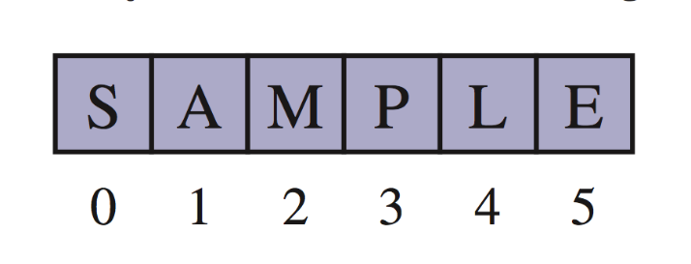
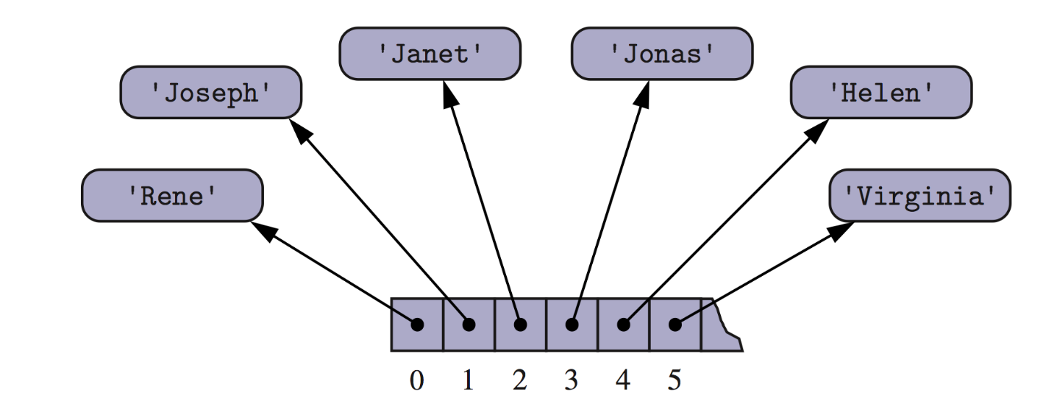
Arrays
An array can store primitive elements, such as characters, giving us a compact array
An array can also store references to objects
© 2013 Goodrich, Tamassia, Goldwasser

Slide 28
Arrays (continued)
Importing the Python array module provides support for compact arrays >>> import array
Array module defines an array class, providing compact storage for arrays of primitive data types
Similar to a Python list but we specify a type code as a first parameter at the time of creation with the constructor
The type code is a character that designates the type of data that will be stored in the array
e.g. floats = array.array(‘f’) (instantiate)
even = array.array(‘i’,[2, 4, 6, 8, 10])

Slide 29
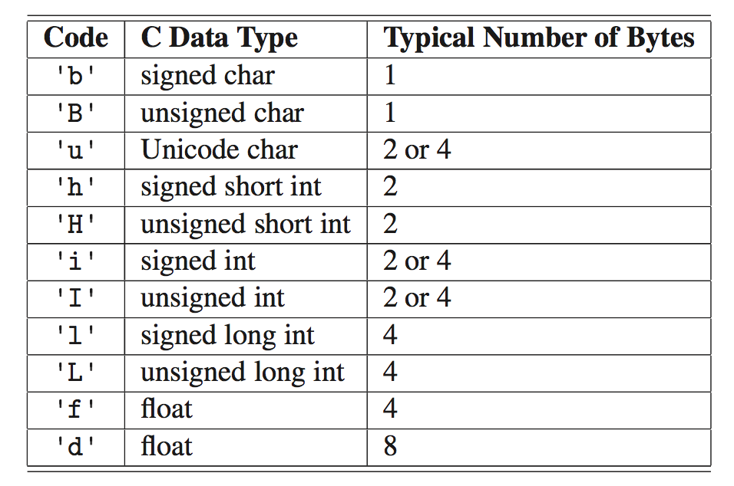
Typecode for arrays

Slide 30
Manipulating arrays using array module
>>> even=array.array('i’,[2,4,6]) // create array
>>> even.typecode //returns typecode
‘i’
>>> even.append(8) //adds 8 to the end of the array
array('i', [2, 4, 6, 8])
>>> even.extend([10,14]) //attaches the iterable to the end of the array
//note–iterable must be of the same primitive
array('i', [2, 4, 6, 8, 10, 14])
>>> even.count(8) //returns count for how many 8s in the array
1
>>> even.index(6) //returns location of FIRST element 6
2

Slide 31
Manipulating arrays using array module
>>> even.insert(5,12) //inserts 12 at location 5
array('i', [2, 4, 6, 8, 10, 12, 14])
>>> even.pop(6) //removes element at location 6 (14)
array('i', [2, 4, 6, 8, 10, 12])
>>> even.remove(4) //returns removes element 4
array('i', [2, 6, 8, 10, 12, 14])
>>> even[3] //return element at location 3
10
>>> even[1:4] //returns slice of elements from locations 1-3
array('i', [6, 8, 10])
>>> even[:4] //returns slice of elements from locations 0-3
array('i', [2, 6, 8, 10])
>>> even[4:] //returns slice of elements from 4-array end
array('i', [12, 14])

Slide 32
Array Access and Memory Allocation
One of the principal reasons arrays are used so widely is that their elements can be accessed in constant time
So the time taken to access a[1] is the same as a[100]
The address of a[i] can be determined arithmetically by adding a suitable offset to the address of the head of the array AND the array is stored contiguously in memory
However, arrays are limited…how efficient would it be to insert or delete elements into an array?
Search: O(n) or O(log n), Insert: O(1) or O(n), Delete: O(1) or O(n)

Slide 33
Insertion (1)
Problem: Given a (sub)array a[left…right], insert a value val at a[ins]. If necessary, shift values right to make way for it.
Array insertion algorithm:
To insert val at index ins in a[left…right] (where left ≤ ins ≤ right):
1. Copy a[ins…right–1] into a[ins+1…right]. 2. Copy val into a[ins]. 3. Terminate.

Slide 34
Insertion (2)
Animation:
To insert val at index ins in a[left…right] (where left ≤ ins ≤ right):
1. Copy a[ins…right–1] into a[ins+1…right]. 2. Copy val into a[ins]. 3. Terminate.
To insert val at index ins in a[left…right] (where left ≤ ins ≤ right):
1. Copy a[ins…right–1] into a[ins+1…right]. 2. Copy val into a[ins]. 3. Terminate.
To insert val at index ins in a[left…right] (where left ≤ ins ≤ right):
1. Copy a[ins…right–1] into a[ins+1…right]. 2. Copy val into a[ins]. 3. Terminate.
To insert val at index ins in a[left…right] (where left ≤ ins ≤ right):
1. Copy a[ins…right–1] into a[ins+1…right]. 2. Copy val into a[ins]. 3. Terminate.
left = 0
left = 0
1
1
2
2
3
3
4
4
5
5
6 = right
left = 0
1
2
3
4
5
6 = right
left = 0
1
2
3
4
5
6 = right
6 = right
a
a
The
The
cat
fat
sat
cat
on
sat
the
on
mouse
a
The
cat
cat
sat
on
the
mouse
a
The
fat
cat
sat
on
the
mouse
the
mouse
val
val
fat
fat
ins
ins
1
val
fat
ins
1
val
fat
ins
1
1

Slide 35
Insertion (3)
Analysis (counting copies):
Let n = right – left + 1 be the length of the array.
Step 2 performs 1 copy.
Step 1 performs between 0 and n–1 copies.
Overall, at most, n copies.
Time complexity is O(n).

Slide 36
Deletion (1)
Problem: Given a (sub)array a[left…right], delete the value in a[del]. If necessary, shift values left to fill the gap. (Assume that left ≤ del ≤ right.)
Array deletion algorithm:
To delete the value at index del in a[left…right] (where left ≤ del ≤ right):
1. Copy a[del+1…right] into a[del…right–1]. 2. Make a[right] unoccupied. 3. Terminate.

Slide 37
Deletion (2)
Animation:
To delete the value at index del in a[left…right] (where left ≤ del ≤ right):
1. Copy a[del+1…right] into a[del…right–1]. 2. Make a[right] unoccupied. 3. Terminate.
To delete the value at index del in a[left…right] (where left ≤ del ≤ right):
1. Copy a[del+1…right] into a[del…right–1]. 2. Make a[right] unoccupied. 3. Terminate.
To delete the value at index del in a[left…right] (where left ≤ del ≤ right):
1. Copy a[del+1…right] into a[del…right–1]. 2. Make a[right] unoccupied. 3. Terminate.
To delete the value at index del in a[left…right] (where left ≤ del ≤ right):
1. Copy a[del+1…right] into a[del…right–1]. 2. Make a[right] unoccupied. 3. Terminate.
left = 0
left = 0
left = 0
left = 0
1
1
1
1
2
2
2
2
3
3
3
3
4
4
4
4
5
5
5
5
6 = right
6 = right
6 = right
6 = right
a
a
a
a
The
The
The
The
fat
cat
cat
cat
cat
sat
sat
sat
sat
on
on
on
on
the
the
the
the
mouse
mouse
mouse
mouse
mouse
del
del
del
del
1
1
1
1

Slide 38
Deletion (3)
Analysis (counting copies):
Let n = right – left + 1 be the length of the array.
Step 1 performs between 0 and n–1 copies.
At most, n–1 copies.
Time complexity is O(n).

Slide 39
Deletion (4)
Why does the deletion algorithm need copying or shifting operations?
Why does an array need continuous occupation?
Otherwise, would the binary search work?

Slide 40
Searching
Problem: Given a (sub)array a[left…right], find which (if any) component equals a given target value.
Choice of algorithms:
linear search (unsorted or sorted array)
binary search (sorted array).

Slide 41
Linear search (1)
Animation (successful search):
To find which (if any) component of a[left…right] equals target:
1. For p = left, …, right, repeat: 1.1. If target equals a[p], terminate with answer p. 2. Terminate with answer none.
To find which (if any) component of a[left…right] equals target:
1. For p = left, …, right, repeat: 1.1. If target equals a[p], terminate with answer p. 2. Terminate with answer none.
To find which (if any) component of a[left…right] equals target:
1. For p = left, …, right, repeat: 1.1. If target equals a[p], terminate with answer p. 2. Terminate with answer none.
To find which (if any) component of a[left…right] equals target:
1. For p = left, …, right, repeat: 1.1. If target equals a[p], terminate with answer p. 2. Terminate with answer none.
To find which (if any) component of a[left…right] equals target:
1. For p = left, …, right, repeat: 1.1. If target equals a[p], terminate with answer p. 2. Terminate with answer none.
To find which (if any) component of a[left…right] equals target:
1. For p = left, …, right, repeat: 1.1. If target equals a[p], terminate with answer p. 2. Terminate with answer none.
To find which (if any) component of a[left…right] equals target:
1. For p = left, …, right, repeat: 1.1. If target equals a[p], terminate with answer p. 2. Terminate with answer none.
To find which (if any) component of a[left…right] equals target:
1. For p = left, …, right, repeat: 1.1. If target equals a[p], terminate with answer p. 2. Terminate with answer none.
To find which (if any) component of a[left…right] equals target:
1. For p = left, …, right, repeat: 1.1. If target equals a[p], terminate with answer p. 2. Terminate with answer none.
left = 0
left = 0
left = 0
left = 0
left = 0
left = 0
left = 0
left = 0
left = 0
1
1
1
1
1
1
1
1
1
2
2
2
2
2
2
2
2
2
3
3
3
3
3
3
3
3
3
4
4
4
4
4
4
4
4
4
5
5
5
5
5
5
5
5
5
6
6
6
6
6
6
6
6
6
7
7
7
7
7
7
7
7
7
8 = right
8 = right
8 = right
8 = right
8 = right
8 = right
8 = right
8 = right
8 = right
a
a
a
a
a
a
a
a
a
rat
rat
rat
rat
rat
rat
rat
rat
rat
cat
cat
cat
cat
cat
cat
cat
cat
cat
pig
pig
pig
pig
pig
pig
pig
pig
pig
cow
cow
cow
cow
cow
cow
cow
cow
cow
fox
fox
fox
fox
fox
fox
fox
fox
fox
lion
lion
lion
lion
lion
lion
lion
lion
lion
tiger
tiger
tiger
tiger
tiger
tiger
tiger
tiger
tiger
goat
goat
goat
goat
goat
goat
goat
goat
goat
dog
dog
dog
dog
dog
dog
dog
dog
dog
target
target
target
target
target
target
target
target
target
cow
cow
cow
cow
cow
cow
cow
cow
cow
p
p
p
p
p
p
p
p
0
0
1
1
2
2
3
3

Slide 42
Linear search (2)
Animation (unsuccessful search):
To find which (if any) component of a[left…right] equals target:
1. For p = left, …, right, repeat: 1.1. If target equals a[p], terminate with answer p. 2. Terminate with answer none.
To find which (if any) component of a[left…right] equals target:
1. For p = left, …, right, repeat: 1.1. If target equals a[p], terminate with answer p. 2. Terminate with answer none.
To find which (if any) component of a[left…right] equals target:
1. For p = left, …, right, repeat: 1.1. If target equals a[p], terminate with answer p. 2. Terminate with answer none.
To find which (if any) component of a[left…right] equals target:
1. For p = left, …, right, repeat: 1.1. If target equals a[p], terminate with answer p. 2. Terminate with answer none.
To find which (if any) component of a[left…right] equals target:
1. For p = left, …, right, repeat: 1.1. If target equals a[p], terminate with answer p. 2. Terminate with answer none.
To find which (if any) component of a[left…right] equals target:
1. For p = left, …, right, repeat: 1.1. If target equals a[p], terminate with answer p. 2. Terminate with answer none.
To find which (if any) component of a[left…right] equals target:
1. For p = left, …, right, repeat: 1.1. If target equals a[p], terminate with answer p. 2. Terminate with answer none.
To find which (if any) component of a[left…right] equals target:
1. For p = left, …, right, repeat: 1.1. If target equals a[p], terminate with answer p. 2. Terminate with answer none.
To find which (if any) component of a[left…right] equals target:
1. For p = left, …, right, repeat: 1.1. If target equals a[p], terminate with answer p. 2. Terminate with answer none.
left = 0
left = 0
left = 0
left = 0
left = 0
left = 0
left = 0
left = 0
left = 0
1
1
1
1
1
1
1
1
1
2 = right
2 = right
2 = right
2 = right
2 = right
2 = right
2 = right
2 = right
2 = right
a
a
a
a
a
a
a
a
a
Li
Li
Li
Li
Li
Li
Li
Li
Li
Nia
Nia
Nia
Nia
Nia
Nia
Nia
Nia
Nia
Omar
Omar
Omar
Omar
Omar
Omar
Omar
Omar
Omar
target
target
target
target
target
target
target
target
target
Raj
Raj
Raj
Raj
Raj
Raj
Raj
Raj
Raj
p
p
p
p
p
p
p
p
0
0
1
1
2
2
3
3

Slide 43
Linear search (3)
Analysis (counting comparisons):
Let n = right – left + 1 be the length of the array.
If the search is unsuccessful, step 1.1 is repeated n times.
No. of comparisons = n
If the search is successful, step 1.1 is repeated between 1 and n times.
In either case, time complexity is O(n).

Slide 44
Binary search (1)
Assume that the (sub)array is sorted.
Consider searching a dictionary for a target word.
Bad idea: Look at page 1, then page 2, etc., until you find the page containing the target word. That is linear search!
Better idea: Choose a page near the middle. If the target word happens to be on that middle page, we’re finished. If the target word is less (greater) than the words on that middle page, focus on the pages before (after) that middle page, and repeat. That is binary search.

Slide 45
Binary search (2)
Animation (successful search):
To find which (if any) component of the sorted (sub)array a[left…right] equals target: 1. Set l = left, and set r = right. 2. While l ≤ r, repeat: 2.1. Let m be an integer about midway between l and r. 2.2. If target equals a[m], terminate with answer m. 2.3. If target is less than a[m], set r = m–1. 2.4. If target is greater than a[m], set l = m+1. 3. Terminate with answer none.
To find which (if any) component of the sorted (sub)array a[left…right] equals target: 1. Set l = left, and set r = right. 2. While l ≤ r, repeat: 2.1. Let m be an integer about midway between l and r. 2.2. If target equals a[m], terminate with answer m. 2.3. If target is less than a[m], set r = m–1. 2.4. If target is greater than a[m], set l = m+1. 3. Terminate with answer none.
To find which (if any) component of the sorted (sub)array a[left…right] equals target: 1. Set l = left, and set r = right. 2. While l ≤ r, repeat: 2.1. Let m be an integer about midway between l and r. 2.2. If target equals a[m], terminate with answer m. 2.3. If target is less than a[m], set r = m–1. 2.4. If target is greater than a[m], set l = m+1. 3. Terminate with answer none.
To find which (if any) component of the sorted (sub)array a[left…right] equals target: 1. Set l = left, and set r = right. 2. While l ≤ r, repeat: 2.1. Let m be an integer about midway between l and r. 2.2. If target equals a[m], terminate with answer m. 2.3. If target is less than a[m], set r = m–1. 2.4. If target is greater than a[m], set l = m+1. 3. Terminate with answer none.
To find which (if any) component of the sorted (sub)array a[left…right] equals target: 1. Set l = left, and set r = right. 2. While l ≤ r, repeat: 2.1. Let m be an integer about midway between l and r. 2.2. If target equals a[m], terminate with answer m. 2.3. If target is less than a[m], set r = m–1. 2.4. If target is greater than a[m], set l = m+1. 3. Terminate with answer none.
To find which (if any) component of the sorted (sub)array a[left…right] equals target: 1. Set l = left, and set r = right. 2. While l ≤ r, repeat: 2.1. Let m be an integer about midway between l and r. 2.2. If target equals a[m], terminate with answer m. 2.3. If target is less than a[m], set r = m–1. 2.4. If target is greater than a[m], set l = m+1. 3. Terminate with answer none.
To find which (if any) component of the sorted (sub)array a[left…right] equals target: 1. Set l = left, and set r = right. 2. While l ≤ r, repeat: 2.1. Let m be an integer about midway between l and r. 2.2. If target equals a[m], terminate with answer m. 2.3. If target is less than a[m], set r = m–1. 2.4. If target is greater than a[m], set l = m+1. 3. Terminate with answer none.
To find which (if any) component of the sorted (sub)array a[left…right] equals target: 1. Set l = left, and set r = right. 2. While l ≤ r, repeat: 2.1. Let m be an integer about midway between l and r. 2.2. If target equals a[m], terminate with answer m. 2.3. If target is less than a[m], set r = m–1. 2.4. If target is greater than a[m], set l = m+1. 3. Terminate with answer none.
To find which (if any) component of the sorted (sub)array a[left…right] equals target: 1. Set l = left, and set r = right. 2. While l ≤ r, repeat: 2.1. Let m be an integer about midway between l and r. 2.2. If target equals a[m], terminate with answer m. 2.3. If target is less than a[m], set r = m–1. 2.4. If target is greater than a[m], set l = m+1. 3. Terminate with answer none.
To find which (if any) component of the sorted (sub)array a[left…right] equals target: 1. Set l = left, and set r = right. 2. While l ≤ r, repeat: 2.1. Let m be an integer about midway between l and r. 2.2. If target equals a[m], terminate with answer m. 2.3. If target is less than a[m], set r = m–1. 2.4. If target is greater than a[m], set l = m+1. 3. Terminate with answer none.
To find which (if any) component of the sorted (sub)array a[left…right] equals target: 1. Set l = left, and set r = right. 2. While l ≤ r, repeat: 2.1. Let m be an integer about midway between l and r. 2.2. If target equals a[m], terminate with answer m. 2.3. If target is less than a[m], set r = m–1. 2.4. If target is greater than a[m], set l = m+1. 3. Terminate with answer none.
left = 0
left = 0
left = 0
left = 0
left = 0
left = 0
left = 0
left = 0
left = 0
left = 0
left = 0
1
1
1
1
1
1
1
1
1
1
1
2
2
2
2
2
2
2
2
2
2
2
3
3
3
3
3
3
3
3
3
3
3
4
4
4
4
4
4
4
4
4
4
4
5
5
5
5
5
5
5
5
5
5
5
6
6
6
6
6
6
6
6
6
6
6
7
7
7
7
7
7
7
7
7
7
7
8 = right
8 = right
8 = right
8 = right
8 = right
8 = right
8 = right
8 = right
8 = right
8 = right
8 = right
a
a
a
a
a
a
a
a
a
a
a
cat
cat
cat
cat
cat
cat
cat
cat
cat
cat
cat
cow
cow
cow
cow
cow
cow
cow
cow
cow
cow
cow
dog
dog
dog
dog
dog
dog
dog
dog
dog
dog
dog
fox
fox
fox
fox
fox
fox
fox
fox
fox
fox
fox
goat
goat
goat
goat
goat
goat
goat
goat
goat
goat
goat
lion
lion
lion
lion
lion
lion
lion
lion
lion
lion
lion
pig
pig
pig
pig
pig
pig
pig
pig
pig
pig
pig
rat
rat
rat
rat
rat
rat
rat
rat
rat
rat
rat
tiger
tiger
tiger
tiger
tiger
tiger
tiger
tiger
tiger
tiger
tiger
target
target
target
target
target
target
target
target
target
target
target
lion
lion
lion
lion
lion
lion
lion
lion
lion
lion
lion
l
l
l
l
l
l
l
l
l
l
0
0
0
5
5
5
5
5
5
5
r
r
r
r
r
r
r
r
r
r
8
8
8
8
8
8
5
5
5
5
m
m
m
m
m
m
m
m
4
4
4
6
6
6
5
5

Slide 46
Binary search (3)
Animation (unsuccessful search):
To find which (if any) component of the sorted (sub)array a[left…right] equals target: 1. Set l = left, and set r = right. 2. While l ≤ r, repeat: 2.1. Let m be an integer about midway between l and r. 2.2. If target equals a[m], terminate with answer m. 2.3. If target is less than a[m], set r = m–1. 2.4. If target is greater than a[m], set l = m+1. 3. Terminate with answer none.
To find which (if any) component of the sorted (sub)array a[left…right] equals target: 1. Set l = left, and set r = right. 2. While l ≤ r, repeat: 2.1. Let m be an integer about midway between l and r. 2.2. If target equals a[m], terminate with answer m. 2.3. If target is less than a[m], set r = m–1. 2.4. If target is greater than a[m], set l = m+1. 3. Terminate with answer none.
To find which (if any) component of the sorted (sub)array a[left…right] equals target: 1. Set l = left, and set r = right. 2. While l ≤ r, repeat: 2.1. Let m be an integer about midway between l and r. 2.2. If target equals a[m], terminate with answer m. 2.3. If target is less than a[m], set r = m–1. 2.4. If target is greater than a[m], set l = m+1. 3. Terminate with answer none.
To find which (if any) component of the sorted (sub)array a[left…right] equals target: 1. Set l = left, and set r = right. 2. While l ≤ r, repeat: 2.1. Let m be an integer about midway between l and r. 2.2. If target equals a[m], terminate with answer m. 2.3. If target is less than a[m], set r = m–1. 2.4. If target is greater than a[m], set l = m+1. 3. Terminate with answer none.
To find which (if any) component of the sorted (sub)array a[left…right] equals target: 1. Set l = left, and set r = right. 2. While l ≤ r, repeat: 2.1. Let m be an integer about midway between l and r. 2.2. If target equals a[m], terminate with answer m. 2.3. If target is less than a[m], set r = m–1. 2.4. If target is greater than a[m], set l = m+1. 3. Terminate with answer none.
To find which (if any) component of the sorted (sub)array a[left…right] equals target: 1. Set l = left, and set r = right. 2. While l ≤ r, repeat: 2.1. Let m be an integer about midway between l and r. 2.2. If target equals a[m], terminate with answer m. 2.3. If target is less than a[m], set r = m–1. 2.4. If target is greater than a[m], set l = m+1. 3. Terminate with answer none.
To find which (if any) component of the sorted (sub)array a[left…right] equals target: 1. Set l = left, and set r = right. 2. While l ≤ r, repeat: 2.1. Let m be an integer about midway between l and r. 2.2. If target equals a[m], terminate with answer m. 2.3. If target is less than a[m], set r = m–1. 2.4. If target is greater than a[m], set l = m+1. 3. Terminate with answer none.
To find which (if any) component of the sorted (sub)array a[left…right] equals target: 1. Set l = left, and set r = right. 2. While l ≤ r, repeat: 2.1. Let m be an integer about midway between l and r. 2.2. If target equals a[m], terminate with answer m. 2.3. If target is less than a[m], set r = m–1. 2.4. If target is greater than a[m], set l = m+1. 3. Terminate with answer none.
To find which (if any) component of the sorted (sub)array a[left…right] equals target: 1. Set l = left, and set r = right. 2. While l ≤ r, repeat: 2.1. Let m be an integer about midway between l and r. 2.2. If target equals a[m], terminate with answer m. 2.3. If target is less than a[m], set r = m–1. 2.4. If target is greater than a[m], set l = m+1. 3. Terminate with answer none.
To find which (if any) component of the sorted (sub)array a[left…right] equals target: 1. Set l = left, and set r = right. 2. While l ≤ r, repeat: 2.1. Let m be an integer about midway between l and r. 2.2. If target equals a[m], terminate with answer m. 2.3. If target is less than a[m], set r = m–1. 2.4. If target is greater than a[m], set l = m+1. 3. Terminate with answer none.
To find which (if any) component of the sorted (sub)array a[left…right] equals target: 1. Set l = left, and set r = right. 2. While l ≤ r, repeat: 2.1. Let m be an integer about midway between l and r. 2.2. If target equals a[m], terminate with answer m. 2.3. If target is less than a[m], set r = m–1. 2.4. If target is greater than a[m], set l = m+1. 3. Terminate with answer none.
To find which (if any) component of the sorted (sub)array a[left…right] equals target: 1. Set l = left, and set r = right. 2. While l ≤ r, repeat: 2.1. Let m be an integer about midway between l and r. 2.2. If target equals a[m], terminate with answer m. 2.3. If target is less than a[m], set r = m–1. 2.4. If target is greater than a[m], set l = m+1. 3. Terminate with answer none.
To find which (if any) component of the sorted (sub)array a[left…right] equals target: 1. Set l = left, and set r = right. 2. While l ≤ r, repeat: 2.1. Let m be an integer about midway between l and r. 2.2. If target equals a[m], terminate with answer m. 2.3. If target is less than a[m], set r = m–1. 2.4. If target is greater than a[m], set l = m+1. 3. Terminate with answer none.
left = 0
left = 0
left = 0
left = 0
left = 0
left = 0
left = 0
left = 0
left = 0
left = 0
left = 0
left = 0
left = 0
1
1
1
1
1
1
1
1
1
1
1
1
1
2
2
2
2
2
2
2
2
2
2
2
2
2
3
3
3
3
3
3
3
3
3
3
3
3
3
4
4
4
4
4
4
4
4
4
4
4
4
4
5
5
5
5
5
5
5
5
5
5
5
5
5
6
6
6
6
6
6
6
6
6
6
6
6
6
7
7
7
7
7
7
7
7
7
7
7
7
7
8 = right
8 = right
8 = right
8 = right
8 = right
8 = right
8 = right
8 = right
8 = right
8 = right
8 = right
8 = right
8 = right
a
a
a
a
a
a
a
a
a
a
a
a
a
cat
cat
cat
cat
cat
cat
cat
cat
cat
cat
cat
cat
cat
cow
cow
cow
cow
cow
cow
cow
cow
cow
cow
cow
cow
cow
dog
dog
dog
dog
dog
dog
dog
dog
dog
dog
dog
dog
dog
fox
fox
fox
fox
fox
fox
fox
fox
fox
fox
fox
fox
fox
goat
goat
goat
goat
goat
goat
goat
goat
goat
goat
goat
goat
goat
lion
lion
lion
lion
lion
lion
lion
lion
lion
lion
lion
lion
lion
pig
pig
pig
pig
pig
pig
pig
pig
pig
pig
pig
pig
pig
rat
rat
rat
rat
rat
rat
rat
rat
rat
rat
rat
rat
rat
tiger
tiger
tiger
tiger
tiger
tiger
tiger
tiger
tiger
tiger
tiger
tiger
tiger
target
target
target
target
target
target
target
target
target
target
target
target
target
dingo
dingo
dingo
dingo
dingo
dingo
dingo
dingo
dingo
dingo
dingo
dingo
dingo
l
l
l
l
l
l
l
l
l
l
l
l
0
0
0
0
0
0
2
2
2
2
2
2
r
r
r
r
r
r
r
r
r
r
r
r
8
8
8
3
3
3
3
3
3
1
1
1
m
m
m
m
m
m
4
4
1
1
2
2

Slide 47
Binary search (4)
Analysis (counting comparisons):
Let n be the length of the array. Assume that steps 2.2–4 perform a single comparison.
If the search is unsuccessful, these steps are repeated as often as we must halve n to reach 0:
No. of comparisons = floor(log₂ n) + 1
If the search is successful, these steps are repeated at most that many times:
Max. no. of comparisons = floor(log₂ n) + 1
In either case, the time complexity is O(log n).

Slide 48
Comparison of searching algorithms
Algorithm | No. of comparisons | Time complexity
Linear search (unsorted array) | ~ n/2 successful n unsuccessful | O(n)
Linear search (sorted array) | ~ n/2 | O(n)
Binary search | ~ log₂ n | O(log n)

